Slide 1
Risk-Base Allocation
10th December 2018

Slide 2
Experiment Parameters
1 Identical Phases
Max 16 Core per Phase
Design Space = 16

Slide 3
Convexity in Execution Time

Slide 4
Convex in Utilization (Active Core Time)
Utilization = Number of Cores * Execution Time
Lower Value is Better

Slide 5
Experiment Parameters
2 Identical Phases
Max 16 Core per Phase
Design Space = 16^2 = 256
DMR = 30%
Deadline = 120

Slide 6
Convexity in Execution Time

Slide 7
Convexity in Utilization

Slide 8
Risk Waterfall

Slide 9
DMR Graph
Optimal Point Must Lie On This Due to Convexity in Utilization
Optimal Points (Risk < DMR & Lowest Utilization)

Slide 10
Greedy Algorithm for Fast Run-Time Results
Descend Concavity in Execution Time
If Risk (A,B) > DMR then choose (A+1, B) if Ex (A+1,B) < Ex (A,B+1).
Stop when Risk (A,B) < DMR
Descend Concavity in Utilization when Risk (A,B) < DMR
Choose (A-1,B) if Risk (A-1,B) < DMR & Util (A-1,B) < Util (B-1,A)
Stop when Risk (A-1,B) > DMR & Risk (A,B-1) > DMR
Maybe can be proven theoretically optimal.

Slide 11
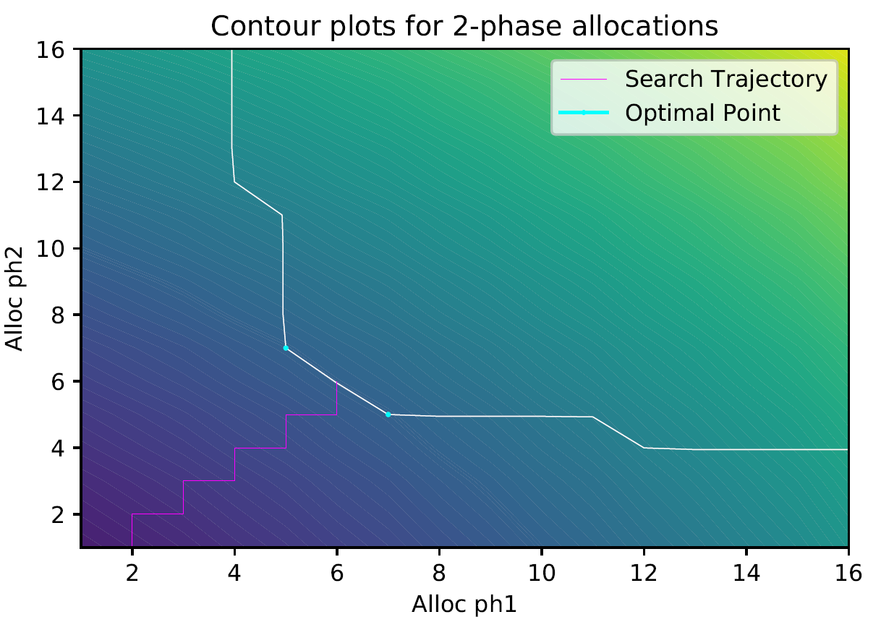
Greedy Trajectory

Slide 12
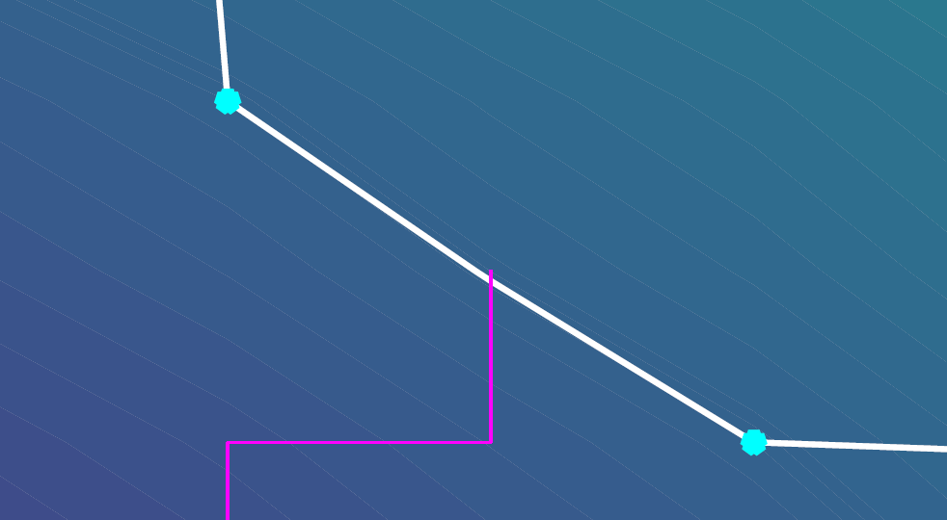
Greedy Performance (Slightly Suboptimal)

Slide 13
DSE Rules (Theoretically Proven)
Rule 1 (Monotonous Lower DMR Elimination):
If Risk (A,B) > DMR then eliminate (A-1,B) & (A, B-1).
Rule 2: (Monotonous Higher Utilization Elimination)
If Risk (A,B) < DMR then eliminate (A+1,B) & (A,B+1).
Rule 3: (Concave Execution Elimination)
If Risk (A,B) > DMR and Ex (A-1,B+1) > Ex (A,B) then eliminate (A-Δ, B+Δ) where Δ = 2 to Min(A-1, MaxCores-B).
Rule 4: (Concave Utilization Elimination)
If Risk (A,B) < DMR and Ut (A-1,B+1) > Ut (A,B) then eliminate (A-Δ, B+Δ) where Δ = Min (A, MaxCores-B).

Slide 14
Experiment Parameters
5 Identical Phases
Max 16 Core per Phase
Design Space = 16^5 = 1048576
DMR = 30%
Deadline = 216

Slide 15
DSE Result (Randomize Search)
Optimal Point Found in only in 200 Steps

Slide 16
Paper Proposals
Paper 1: Offline DSE to save power for 1 task in the system only.
Bring in DVFS too.
Paper 2: Run-Time Greedy to Minimize DMR with multiple task in the system.

